Slide 1

Software Testing
Unit 2
Unit Testing
Prof Raghu B. A. Rao
Department of Computer Science and Engineering
‹#›
‹#›

Slide 2

Unit Testing
List of Contents
Unit Testing
Unit Testing Tools
Why Unit Testing
How to do Unit Testing
How does Unit Testing work?
Unit Testing Techniques, Adv & Disadv
Test Driven Development (TDD)
Refactoring
Unit Testing Checklist
Department of Computer Science and Engineering

Slide 3
Unit Testing
Individual units or components of a software are tested.
Purpose is to validate that each unit of the software code performs as expected.
Done during the development (coding phase) of an application by the developers.
A unit may be an individual function, method, procedure, module, or object.
Unit testing is first level of testing done before integration testing.
White Box testing technique that is usually performed by the developer.

Slide 4
Unit Testing Tools
There are several automated unit test softwares available:
Junit: Junit is a free to use testing tool (i.e. Java unit testing framework) used for Java programming language. It provides assertions to identify test method. This tool test data first and then inserted in the piece of code.
NUnit: NUnit is widely used unit-testing framework use for all .net languages. It is an open source tool which allows writing scripts manually. It supports data-driven tests which can run in parallel.
JMockit: JMockit is open source Unit testing tool. It is a code coverage tool with line and path metrics. It allows mocking API with recording and verification syntax. This tool offers Line coverage, Path Coverage, and Data Coverage.
Assert is a method useful in determining Pass or Fail status of a test case.
Assertion methods are useful in writing test cases and to detect test failure.
The assert methods are provided by the class org.junit.Assert which extends java.lang.Object class.
Types of assertions : Boolean, Null, Identical etc.
Ref: https://www.guru99.com/junit-assert.html
Notes:
JUnit is a Java unit testing framework that's one of the best test methods for regression testing. An open-source framework, it is used to write and run repeatable automated tests
It is a free, open source, community-focused unit testing tool for the .NET Framework

Slide 5
Unit Testing Tools (Cont.)
There are several automated unit test softwares available:
EMMA: EMMA is an open-source toolkit for analyzing and reporg code written in Java language. Emma support coverage types like method, line, basic block. It is Java-based so it is without external library dependencies and can access the source code.
PHPUnit: PHPUnit is a unit testing tool for PHP programmer. It takes small portions of code which is called units and test each of them separately. The tool also allows developers to use pre-define assertion methods to assert that a system behave in a certain manner.
Notes:
JUnit is a Java unit testing framework that's one of the best test methods for regression testing. An open-source framework, it is used to write and run repeatable automated tests
It is a free, open source, community-focused unit testing tool for the .NET Framework

Slide 6
Why Unit Testing
It reduces defect cost.
Saves time and money.
Increases confidence in code maintenance.
Makes code reusable.
Increases development speed.
Makes code more reliable.
Makes debugging more easy.

Slide 7
Unit Testing
Acceptance Testing
Unit tests help to fix bugs early in the development cycle and save costs.
It helps the developers to understand the testing code base and enables them to make changes quickly
Good unit tests serve as project documentation
Unit tests help with code reuse. Migrate both your code and your tests to your new project. Tweak the code until the tests run again.
System Testing
Integration Testing
Unit Testing

Slide 8
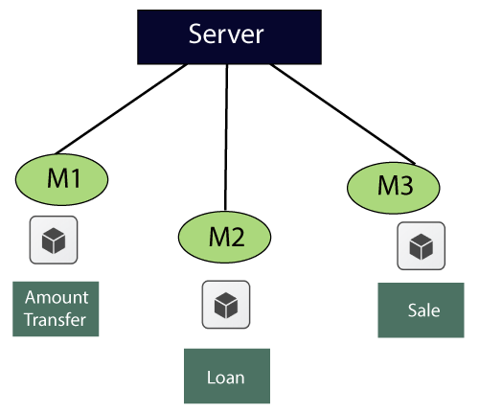
Unit Testing - Example
Let us see one sample example for a better understanding of the concept of unit testing:
Follow this link to view detailed example referring to the above image : https://www.javatpoint.com/unit-testing

Slide 9
How to do Unit Testing
Unit Testing is of two types
Manual
Automated
Unit testing is commonly automated but may still be performed manually. Software Engineering does not favor one over the other but automation is preferred.

Slide 10
Unit Testing - How it works?
Under the automated approach-
A developer writes a section of code in the application just to test the function. They would later comment out and finally remove the test code when the application is deployed.
A developer could also isolate the function to test it more rigorously. This is a more thorough unit testing practice that involves copy and paste of code to its own testing environment than its natural environment. Isolating the code helps in revealing unnecessary dependencies between the code being tested and other units or data spaces in the product. These dependencies can then be eliminated.
A coder generally uses a UnitTest Framework to develop automated test cases. Using an automation framework, the developer codes criteria into the test to verify the correctness of the code. During execution of the test cases, the framework logs failing test cases. Many frameworks will also automatically flag and report, in summary, these failed test cases. Depending on the severity of a failure, the framework may halt subsequent testing.
The workflow of Unit Testing is :
1. Create Test Cases
2) Review/Rework
3) Baseline
4) Execute Test Cases.

Slide 11
Unit Testing Techniques
Categorized into three parts
Black box testing - that involves testing of user interface along with input and output
White box testing - that involves testing the functional behaviour of the software application
Gray box testing - that is used to execute test suites, test methods, test cases and performing risk analysis.

Slide 12
Unit Testing - Advantages
Developers looking to learn what functionality is provided by a unit and how to use it can look at the unit tests to gain a basic understanding of the unit API.
Unit testing allows the programmer to refactor code at a later date, and make sure the module still works correctly (i.e. Regression testing). The procedure is to write test cases for all functions and methods so that whenever a change causes a fault, it can be quickly identified and fixed.
Due to the modular nature of the unit testing, we can test parts of the project without waiting for others to be completed.

Slide 13
Unit Testing - Disadvantages
Unit testing can't be expected to catch every error in a program. It is not possible to evaluate all execution paths even in the most trivial programs
Unit testing by its very nature focuses on a unit of code. Hence it can't catch integration errors or broad system level errors.

Slide 14
Test Driven Development - TDD
A new testing technique by advocates of Extreme Programming.
Introduction to TDD : “Test-Driven Development” by Kent Beck.
Two simple rules
Write a failing automated test before writing any code
Remove duplicates

Slide 15
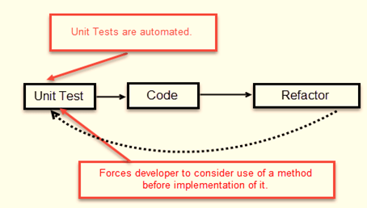
TDD process
Test-Driven Development (TDD) involves designing and creating tests for each application function, with developers writing new code only when automated tests fail. This prevents code duplication and encourages writing minimal code to pass tests, prioritizing requirement conditions.

Slide 16
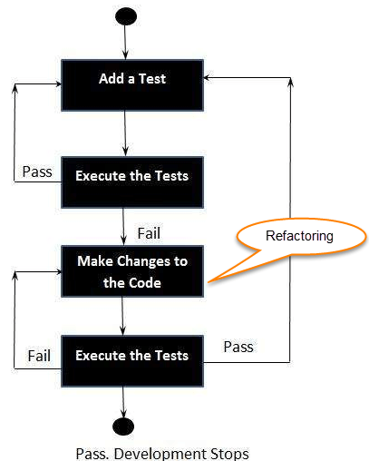
Steps in TDD
Following steps define how to perform TDD test,
Add a test.
Run all tests and see if any new test fails.
Write some code.
Run tests and Refactor code.
Repeat.

Slide 17
TDD advantages
It promotes affirmative testing of the application and it's specifications.
TDD makes code simpler and clear.
Reduces the documentation process at developers end.

Slide 18
Refactoring
Martin Fowler, the pioneer of refactoring, compiled industry best practices into a defined list of refactorings and detailed their implementation in his book "Refactoring: Improving Existing Code."
Refactoring is the process of changing a software system in such a way that it does not alter the external behavior of the code yet improves the internal architecture.
Refactoring can help mitigate code thrashing, a situation where different developers introduce conflicting changes. By following established refactoring patterns and principles, teams can minimize conflicts and improve code collaboration.
Refactoring improves code by making it:
More efficient by addressing dependencies and complexities.
More maintainable or reusable by increasing efficiency and readability.
Cleaner so it is easier to read and understand.
Easier for software developers to find and fix bugs or vulnerabilities in the code.

Slide 19
Unit Testing Checklist
Write unit tests for all code
Don’t postpone the tests
Ensure that the code passes unit tests and integration tests before check-ins
Use automated tools such as NUnit
Check the tests and any other setup files into SCC
Consider using TDD for 100% coverage
Refactor code only when there are thorough set of tests for the code

Slide 20
THANK YOU
Introduction to Software Quality & Testing
Prof Raghu B. A. Rao
Department of Computer Science and Engineering
‹#›

